Slide 1
COMP 2230
Week 15 - Monday

Slide 2
Last time
Reviewed first third of the course

Slide 3
Questions?

Slide 4
Assignment 6

Slide 5
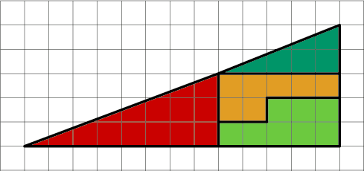
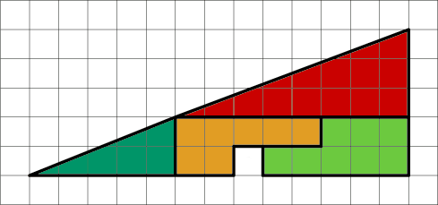
Logical warmup
Consider the following shape to the right:
Now, consider the next shape, made up of pieces of exactly the same size:
We have created space out of nowhere!
How is this possible?

Slide 6
Final exam
Final exam:
  Wednesday, April 29, 2026
  8:00 to 10:00 a.m.
  50% longer than previous exams, but you'll have 100% more time
There will be short answer, diagrams, and proofs
It will be comprehensive but weighted toward the last quarter of the course

Slide 7
Set Theory

Slide 8
Set theory basics
Defining finite and infinite sets
Definitions of:
  Subset
  Proper subset
  Set equality
Set operations:
  Union
  Intersection
  Difference
  Complement
The empty set
Partitions
Cartesian product

Slide 9
Set theory proofs
Proving a subset relation
  Element method: Assume an element is in one set and show that it must be in the other set
  Algebraic laws of set theory: Using the algebraic laws of set theory (given on the next slide), we can show that two sets are equal
Disproving a universal statement requires a counterexample with specific sets

Slide 10
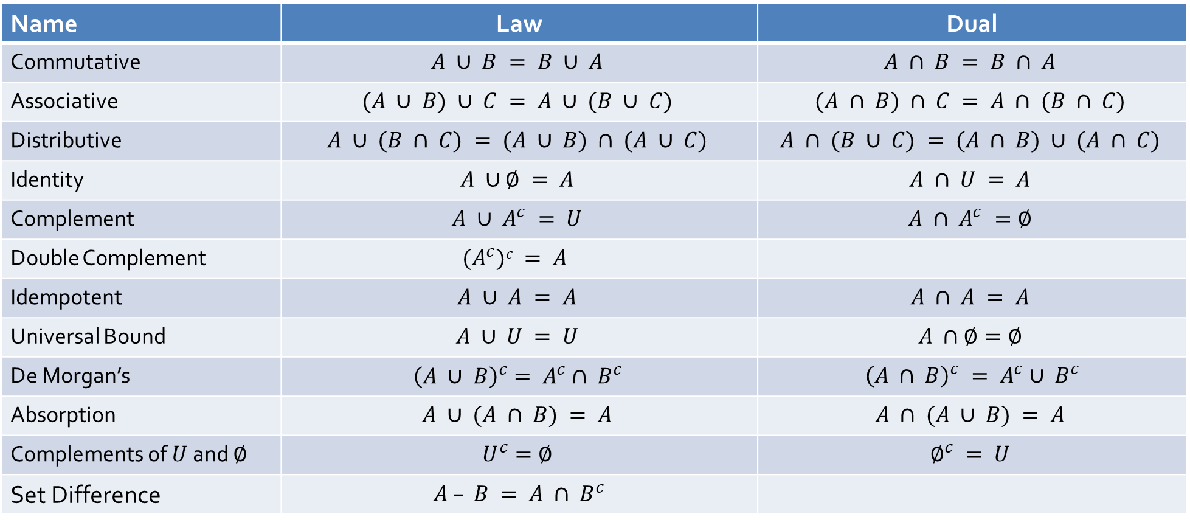
Laws of set theory
Name | Law | Dual
Commutative | $$A ∪ B = B ∪ A$$ | $$A ∩ B = B ∩ A$$
Associative | $$(A ∪ B) ∪ C = A ∪ (B ∪ C)$$ | $$(A ∩ B) ∩ C = A ∩ (B ∩ C)$$
Distributive | $$A ∪ (B ∩ C) = (A ∪ B) ∩ (A ∪ C)$$ | $$A ∩ (B ∪ C) = (A ∩ B) ∪ (A ∩ C)$$
Identity | $$A ∪∅ = A$$ | $$A ∩ U = A$$
Complement | $$A ∪ A^{c} = U$$ | $$A ∩ A^{c} =∅$$
Double Complement | $$(A^{c})c = A$$
Idempotent | $$A ∪ A = A$$ | $$A ∩ A = A$$
Universal Bound | $$A ∪ U = U$$ | $$A ∩∅=∅$$
De Morgan’s | $${\left(A ∪ B\right)}^{c}= A^{c}∩ B^{c}$$ | ${\left(A ∩ B\right)}^{c} = A^{c}∪ B^{c}$
Absorption | $$A ∪ (A ∩ B) = A$$ | $$A ∩ (A ∪ B) = A$$
Complements of $U$ and $∅$ | $$U^{c}=∅$$ | $$∅^{c} = U$$
Set Difference | $A – B = A ∩ B^{c}$

Slide 11

Set theory proof example
Use the element method to prove the following:
For all sets $A$, $B$, and $C$, if $A⊆B$ then $A∩C⊆B∩C$

Slide 12
Russell's paradox
It is possible to give a description for a set which describes a set that does not actually exist
For a well-defined set, we should be able to say whether or not a given element is or is not a member
If we can find an element that must be in a specific set and must not be in a specific set, that set is not well defined
Watch out for definitions that are logically inconsistent!

Slide 13
Functions
One-to-one (injective) functions
Onto (surjective) functions
If a function is both one-to-one and onto, we call it bijective

Slide 14
Cardinality
Cardinality is the number of things in a set
  It is reflexive, symmetric, and transitive
Two sets have the same cardinality if a bijective function maps every element in one to an element in the other
Any set with the same cardinality as positive integers is called countably infinite

Slide 15
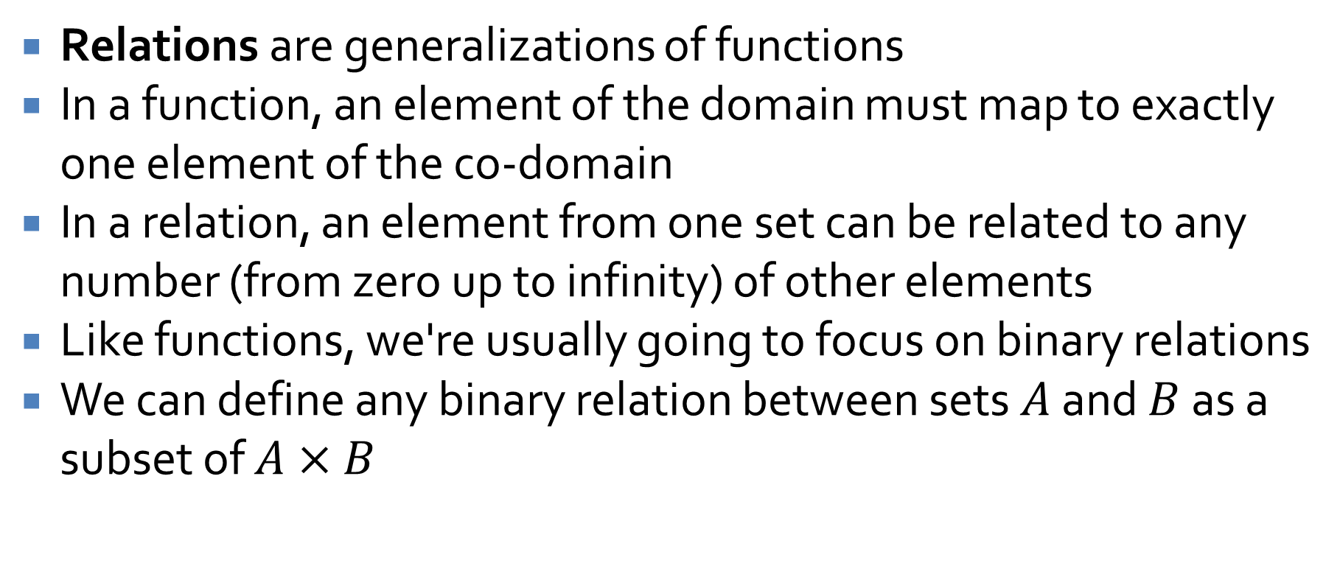
Relations
Relations are generalizations of functions
In a function, an element of the domain must map to exactly one element of the co-domain
In a relation, an element from one set can be related to any number (from zero up to infinity) of other elements
Like functions, we're usually going to focus on binary relations
We can define any binary relation between sets $A$ and $B$ as a subset of $A×B$

Slide 16
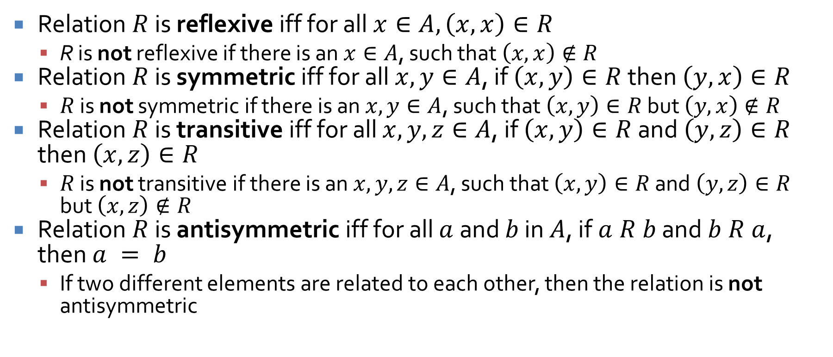
Properties
Relation $R$ is reflexive iff for all $x∈A, \left(x, x\right)∈R$
  R is not reflexive if there is an $x∈A$, such that $\left(x, x\right)∉R$
Relation $R$ is symmetric iff for all $x, y∈A$, if $\left(x, y\right)∈R$ then $\left(y, x\right)∈R$
  $R$ is not symmetric if there is an $x, y∈A$, such that $\left(x, y\right)∈R$ but $\left(y, x\right)∉R$
Relation $R$ is transitive iff for all $x, y, z∈A$, if $\left(x, y\right)∈R$ and $\left(y, z\right)∈R$ then $\left(x, z\right)∈R$
  $R$ is not transitive if there is an $x, y, z∈A$, such that $\left(x, y\right)∈R$ and $\left(y, z\right)∈R$ but $\left(x, z\right)∉R$
Relation $R$ is antisymmetric iff for all $a$ and $b$ in $A$, if $a R b$ and $b R a$, then $a = b$
  If two different elements are related to each other, then the relation is not antisymmetric

Slide 17
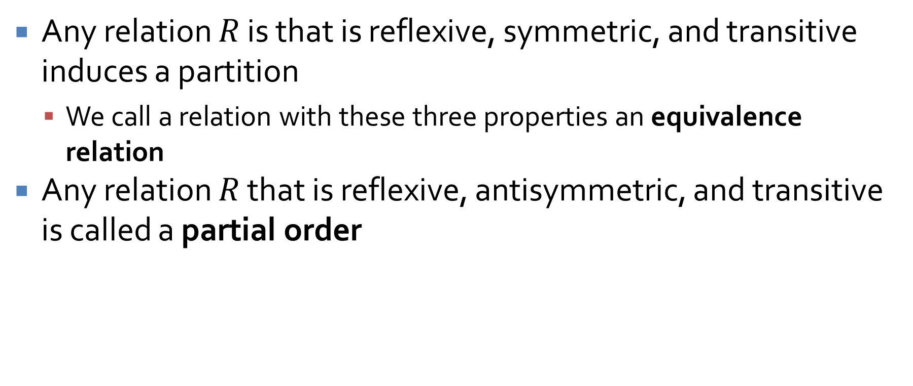
Kinds of relations
Any relation $R$ is that is reflexive, symmetric, and transitive induces a partition
  We call a relation with these three properties an equivalence relation
Any relation $R$ that is reflexive, antisymmetric, and transitive is called a partial order

Slide 18
Counting and Probability

Slide 19
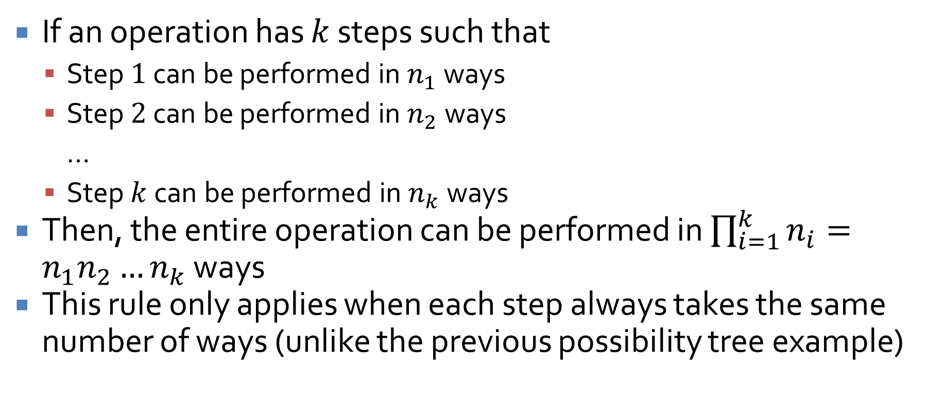
Multiplication rule
If an operation has $k$ steps such that
  Step $1$ can be performed in $n_{1}$ ways
  Step $2$ can be performed in $n_{2}$ ways
  …
  Step $k$ can be performed in $n_{k}$ ways
Then, the entire operation can be performed in $\prod_{i=1}^{k}{n_{i}}=n_{1}n_{2}…n_{k}$ ways
This rule only applies when each step always takes the same number of ways (unlike the previous possibility tree example)

Slide 20
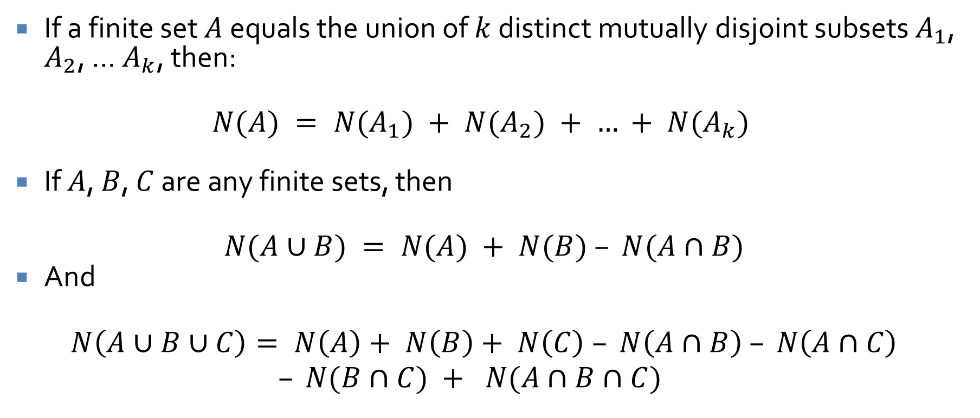
Addition and inclusion/exclusion rules
If a finite set $A$ equals the union of $k$ distinct mutually disjoint subsets $A_{1}$, $A_{2}$, … $A_{k}$, then:
$$N(A) = N(A_{1}) + N(A_{2}) + … + N(A_{k})$$
If $A$, $B$, $C$ are any finite sets, then
$$N(A∪B) = N(A) + N(B) – N(A∩B)$$
And
$$N\left(A∪B∪C\right)= N\left(A\right)+ N\left(B\right)+ N\left(C\right) – N\left(A∩B\right) – N\left(A∩C\right)$$
$$– N(B∩C) + N(A∩B∩C)$$

Slide 21
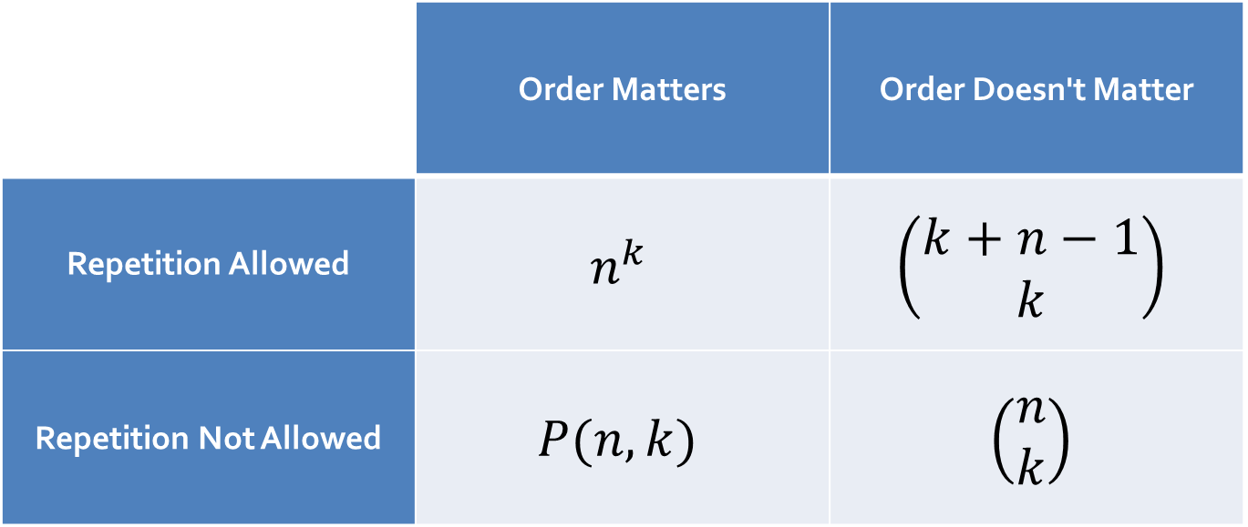
Handy dandy guide to counting
This is a quick reminder of all the different ways you can count things:
 | Order Matters | Order Doesn't Matter
Repetition Allowed | $$n^{k}$$ | $$\left(\begin{matrix}k+n−1 \\ k\end{matrix}\right)$$
Repetition Not Allowed | $$P(n,k)$$ | $$\left(\begin{matrix}n \\ k\end{matrix}\right)$$

Slide 22
How many ways are there to…
Order the letters in the word "lunacy"
Order any four letters in the word " lunacy"?
Order the letters in the word "sassafras"
  If all letters are considered distinct?
  If identical letters cannot be told apart?
Select a soccer team of 11 people from 50 candidates?
Select a soccer team of 11 people from 50 candidates and make one of the 11 the goalie?
Select a soccer team of 11 people from 25 men and 25 women where five must be women, five must be men, and the goalie can be either?

Slide 23
How many ways are there to…
How many Java identifiers of exactly 8 characters are possible?
How many Java identifiers of up to 8 characters are possible?
How many ways are there to select a basket of 15 pastries made up of:
  Croissants
  Pain au chocolat
  Kouign-amann
  Cheese danish

Slide 24
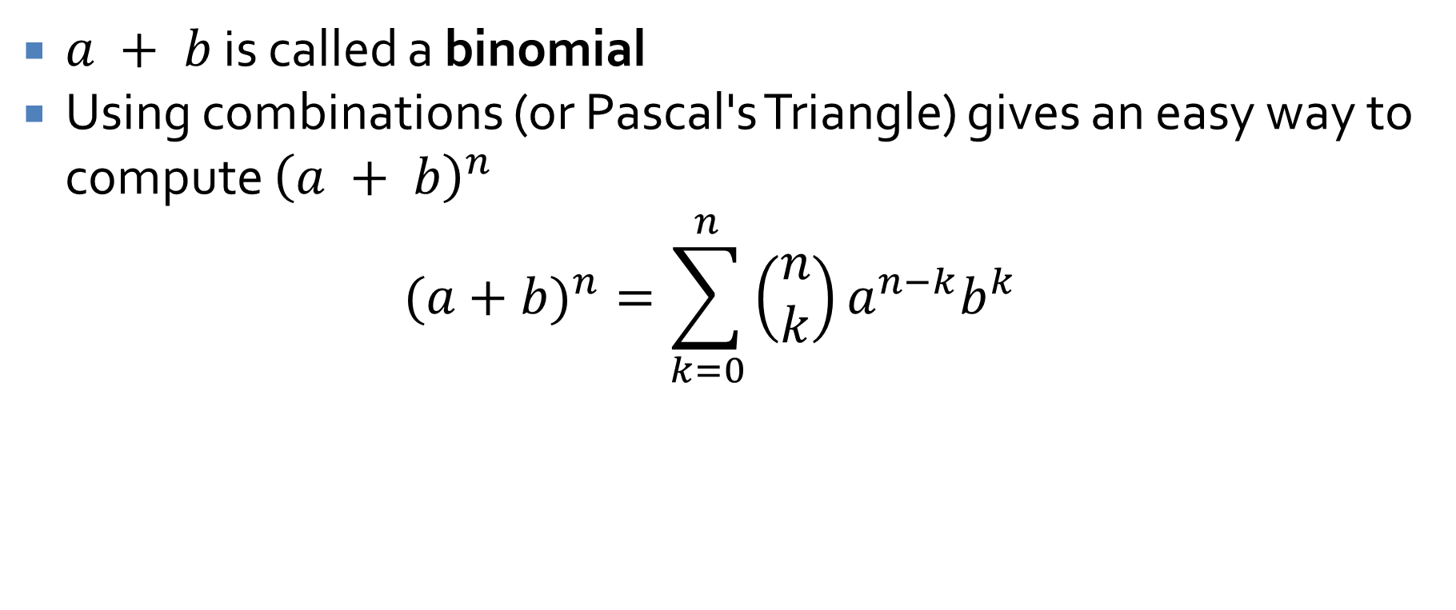
Binomial theorem
$a + b$ is called a binomial
Using combinations (or Pascal's Triangle) gives an easy way to compute ${\left(a + b\right)}^{n}$
$$(a+b)^{n}=\sum_{k=0}^{n}{\left(\begin{matrix}n \\ k\end{matrix}\right)}a^{n−k}b^{k}$$

Slide 25
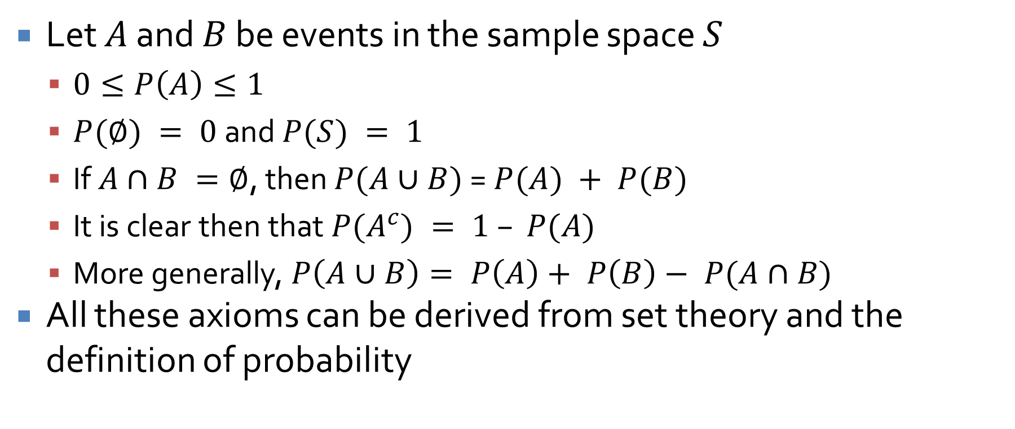
Probability axioms
Let $A$ and $B$ be events in the sample space $S$
  $0≤P\left(A\right)≤1$
  $P(∅) = 0$ and $P(S) = 1$
  If $A∩B =∅$, then $P(A∪B)$ = $P(A) + P(B)$
  It is clear then that $P(A^{c}) = 1 – P(A)$
  More generally, $P\left(A∪B\right)= P\left(A\right)+ P\left(B\right)− P(A∩B)$
All these axioms can be derived from set theory and the definition of probability

Slide 26
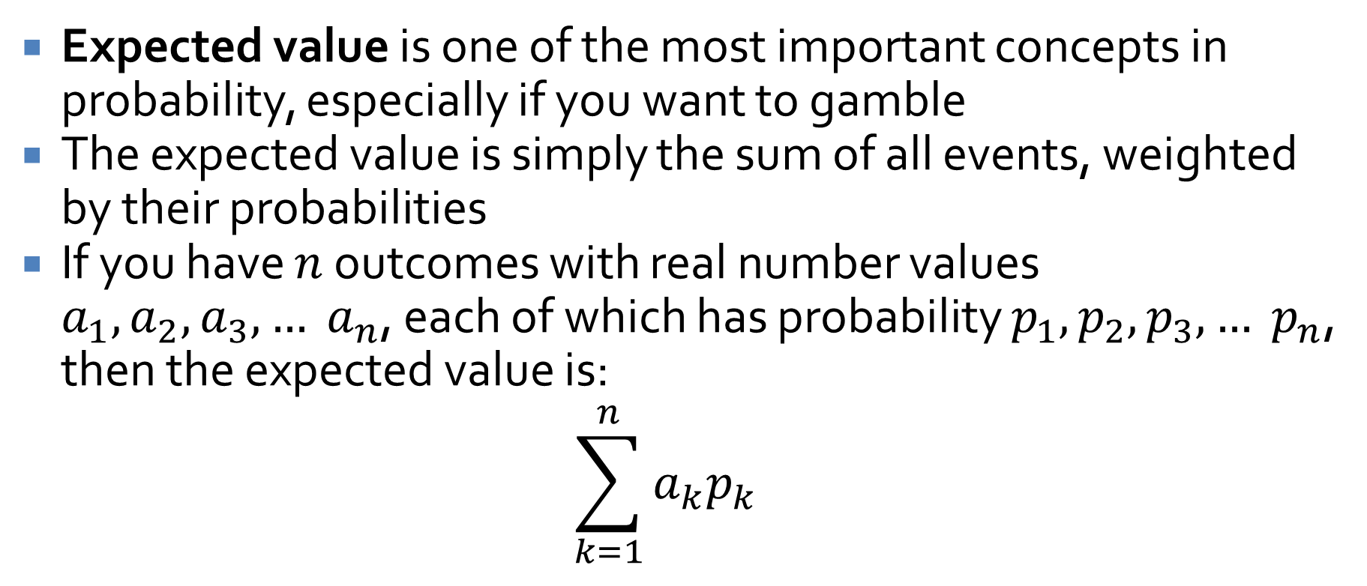
Expected value
Expected value is one of the most important concepts in probability, especially if you want to gamble
The expected value is simply the sum of all events, weighted by their probabilities
If you have $n$ outcomes with real number values $a_{1}, a_{2}, a_{3},… a_{n}$, each of which has probability $p_{1}, p_{2}, p_{3},… p_{n}$, then the expected value is:
$$\sum_{k=1}^{n}{a_{k}p_{k}}$$

Slide 27
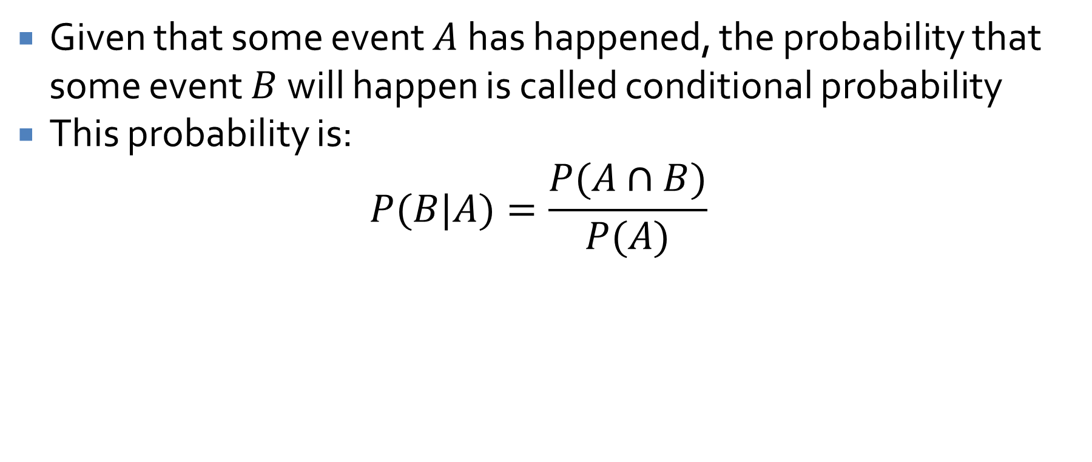
Conditional probability
Given that some event $A$ has happened, the probability that some event $B$ will happen is called conditional probability
This probability is:
$$P(B|A)=\frac{P(A∩B)}{P(A)}$$

Slide 28
Ticket Out the Door

Slide 29
Upcoming

Slide 30
Next time…
Review of third third of the course

Slide 31
Reminders
Finish Assignment 6
  Due Wednesday!
Final exam:
  Wednesday, April 29, 2026
  8:00 to 10:00 a.m.

